Slide 1
Machine Learning HW#5
Javier Salazar
1001144647

Slide 2
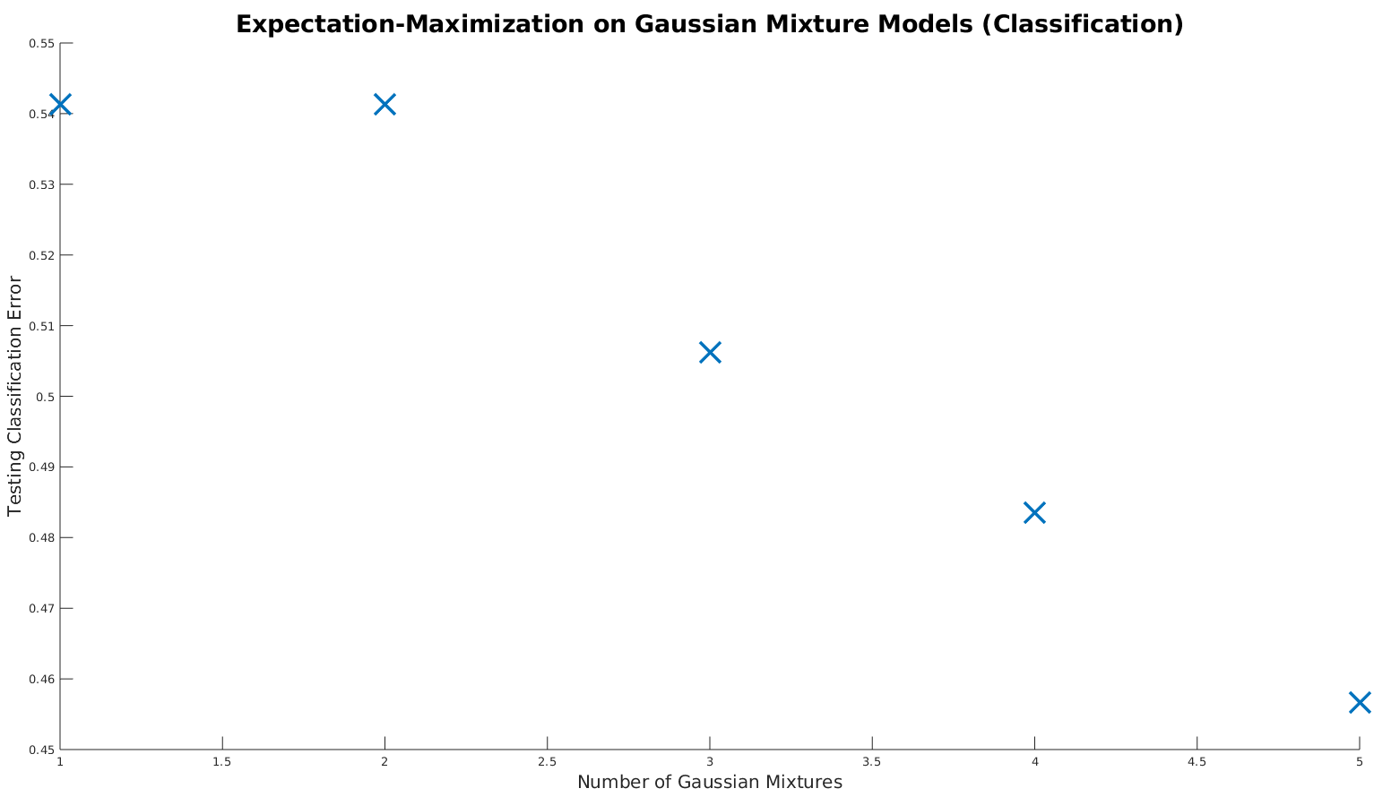
Testing Misclassification Plot

Slide 3
Problem 1 Analysis
Default sigma of 1 was very large in comparison to training data values so I brought it down to 0.1 to get better results
For Q = 5 gaussians, we have misclassification error probability of 0.46 so performing EM on GMM correctly classified data 54% of the time which is better than the 10% classification rate if we flip a 10-sided die

Slide 4
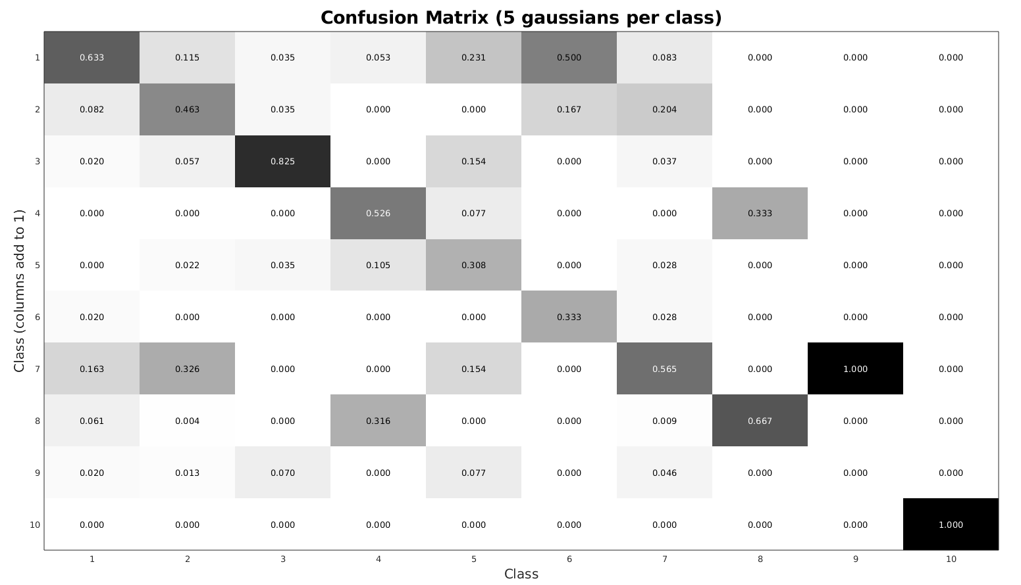
Confusion Matrix

Slide 5
Problem 1 Analysis
Matrix visualization code to plot matrices taken from here: https://stackoverflow.com/questions/3942892/how-do-i-visualize-a-matrix-with-colors-and-values-displayed
We can see that the matrix is mostly the largest along diagnal so classes are usually identified correctly except for class 9 and 6 that had higher misclassification
Not sure if the matrix is transposed or not but I have it so that the columns of the matrix add up to 1 like how Matlab has it in their confusionmat(.) function documentation

